Slide 1

Reddit Sentimental Analysis using Text Mining
By Yasaswi Sai Niharika Avula(avula1y),
Charan Sai Guntupalli(guntu1c),
Lakshmi Sudha Aluru(aluru1l)

Slide 2



Data Description
1
Data Scraping
Realtime reddit post’s subreddits/comments are collected into a list using Data scraping.
2
Data Size
a total of 432 sentences or subreddits are collected from a selected reddit post.
3
Libraries used
praw,
emoji,
pandas,
nltk, nltk.sentiment.vader(vader_lexicon)
re,
en_core_web_sm, spacy,
WordClould,
matplotlib,
Seaborn
plotly

Slide 3
Project flow:
Create an application for getting client ID and client secret
Create a Reddit connection with our client ID and client secret
Obtain Comments From A Reddit Post
Preprocess the comments or Cleaning the comments
Apply a Sentimental Analyzer
Representation of Sentimental Results
Visualization using Word Clouds

Slide 4
Create an application for getting client ID and client secret

Slide 5
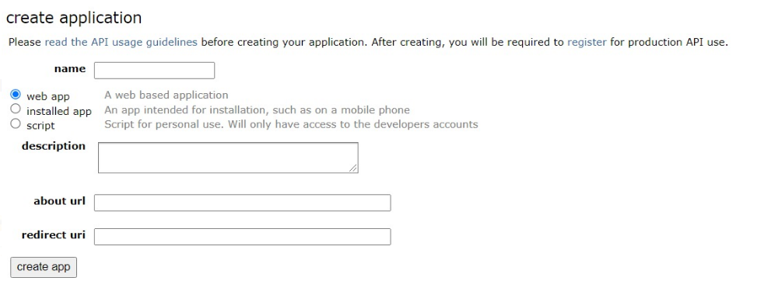
For creating an application goto https://www.reddit.com/prefs/apps.

Slide 6
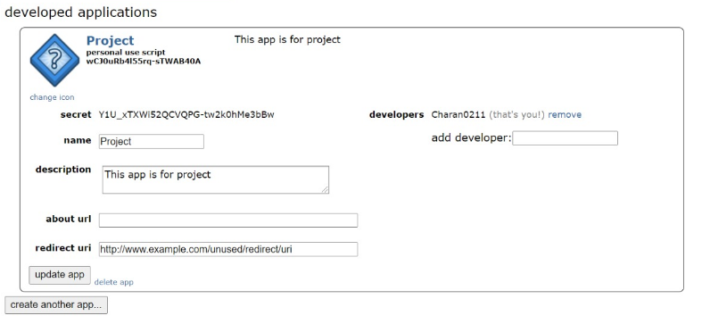
After the application is created,
As Reddit’s API uses OAuth2, a Reddit connection must be established with a client ID and client secret.

Slide 7
Create a Reddit connection with our client ID and client secret

Slide 8
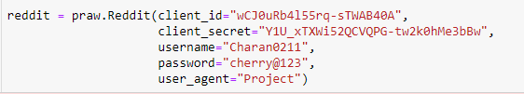
Establishing a Reddit connection with our client ID and client secret.
Then assigns it to a dataframe

Slide 9
Obtaining Comments From A Reddit Post

Slide 10
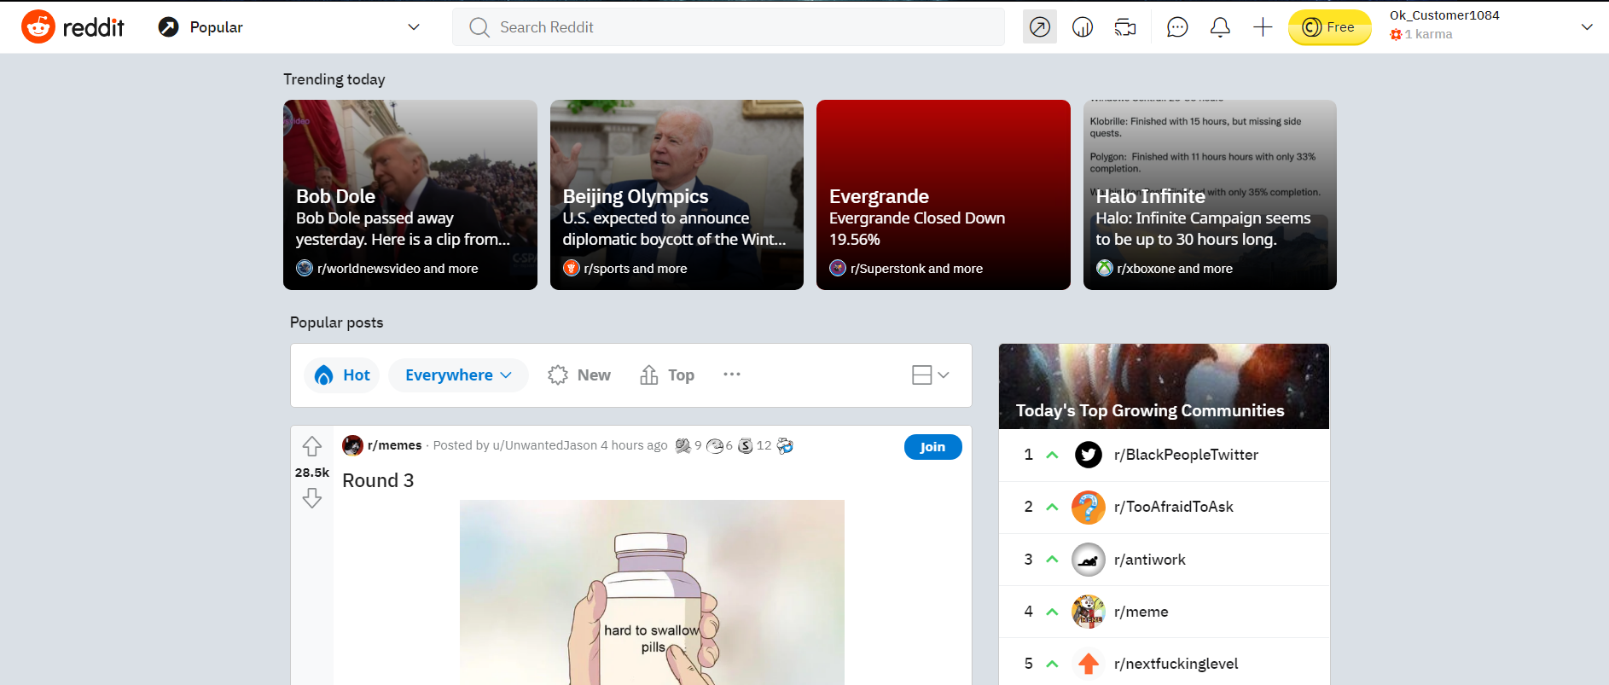
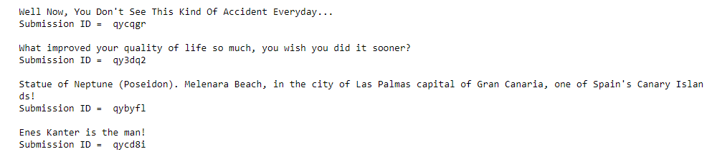
By using subreddit('popular') getting the comments for popular posts
Ex: subreddit = reddit.subreddit('popular')

Slide 11
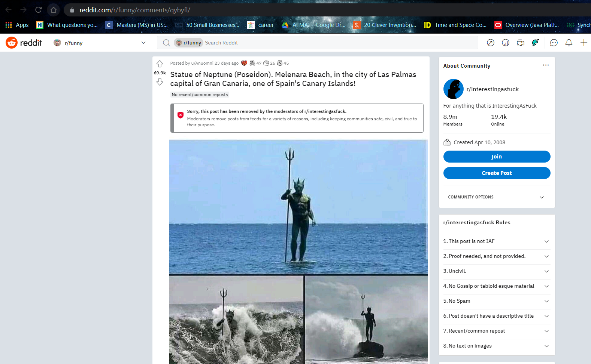
Consider One of the Trending posts that we’ve retrieved the submission id of.

Slide 12
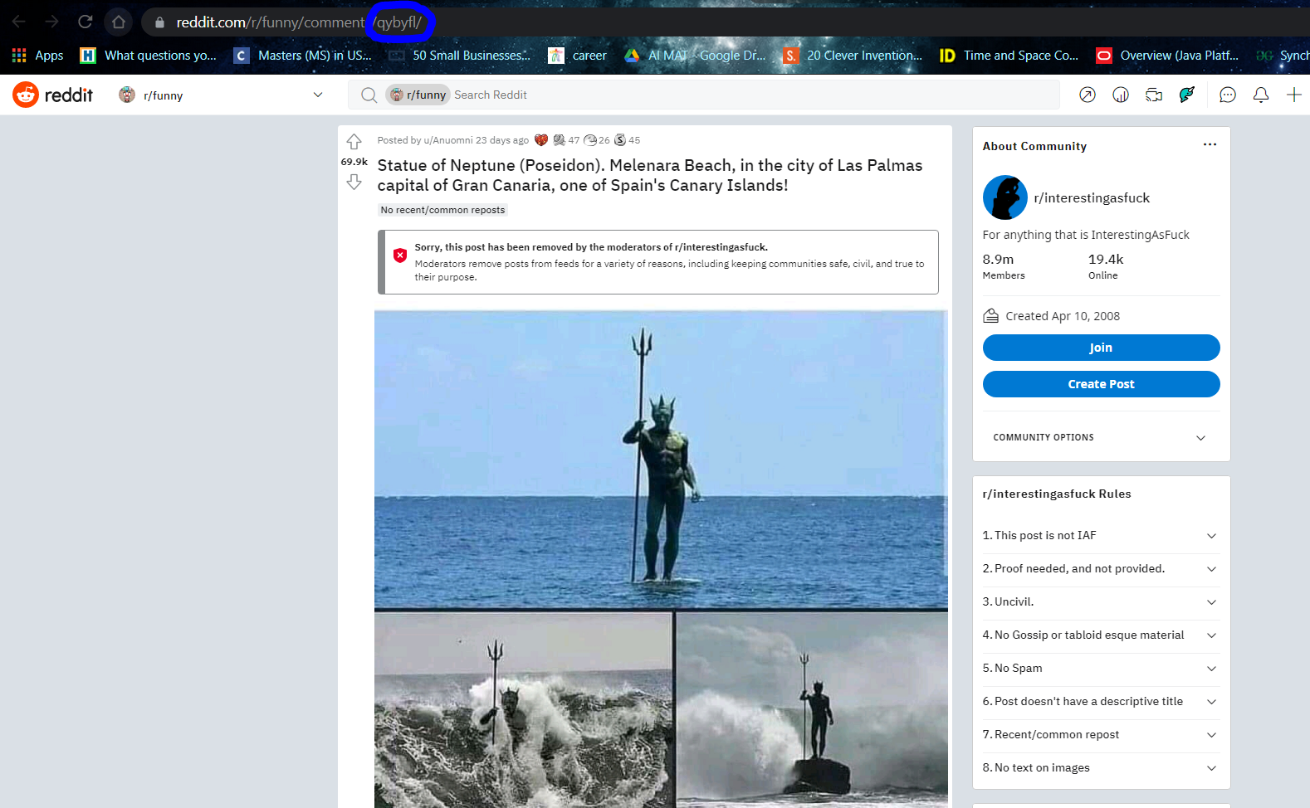
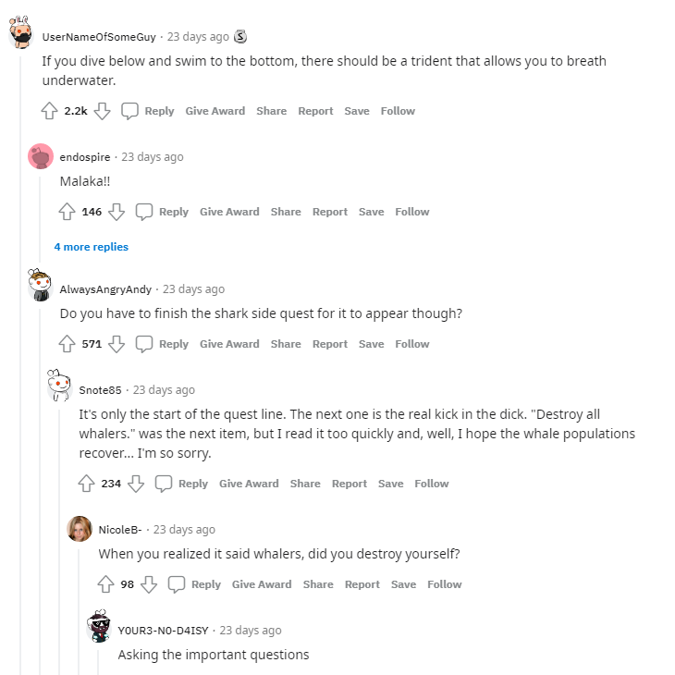
Use submission Id: qybyfl of the post to get the comments under it.

Slide 13
Preprocess the comments or Cleaning the comments

Slide 14
Defining a submission object
Ex: Post1 = reddit.submission(id='qybyfl')
Store all the comments from the post in a list
Turning the comments into list instead of a single string - to navigate easily.
join all the strings separated by a comma Ex: string_uncleaned = ' , '.join(List1)
Remove all the emojis =
Tokenize and clean the strings- breaks the raw text into words, sentences called tokens Ex: i wonder how long that statue will last? = [i], [wonder], [how], [long], [that], [statue], [will], [last]

Slide 15
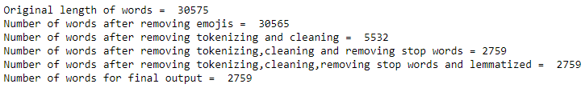
Convertings all the strings in to lower case Ex: “Stem” = “stem”
Removing all the stopwords Ex: “a”, “the”, “is”, “are” and etc are common stopwords in english are removed as they are very little useful information.
Normalizing the words using lemmatization- It is helpful in reducing the no.of unique tokens present in the text, removing the variations in a text.
Ex: =
Normalizing the words using stemming- reducing a word to its word stem Ex:
=
After Cleaning and Preprocessing the comments on the reddit post(with id ‘qybyfl’)

Slide 16
Apply a Sentimental Analyzer

Slide 17
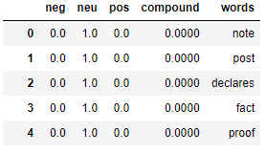

Finding the polarity of words. analyze a body of text for understanding the opinion expressed by it. Either positive or negitive.(we can perform this by nltk.sentiment.vader importing from SentimentIntensityAnalyzer
Adding a label to each word
Where compound score is a normalized single unidimensional measure of sentiment for a given sentence.
Typical threshold values, ›= +0.05 (Positive) / «= -0.05 (Negative) / 0.05 ~ -0.05 (NeutraL)

Slide 18
Representation of Sentimental Results

Slide 19

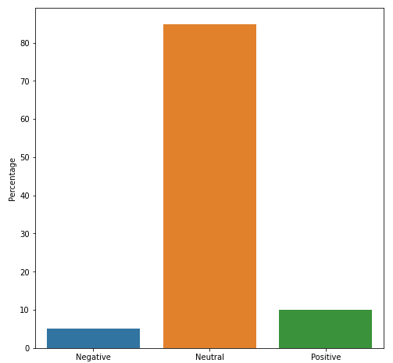
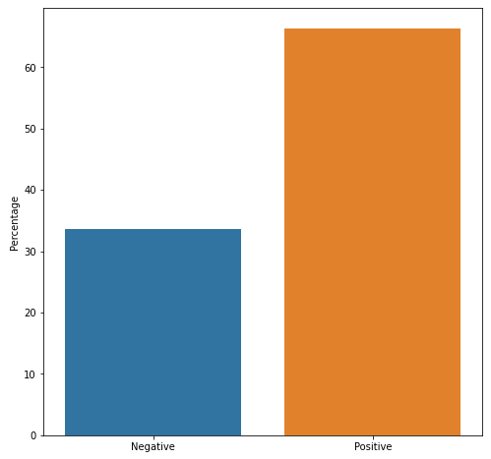
Label count for each word(df.label.value_counts())
a graph with positive , neutral and positive
Remove neutral words and display it(df.loc[df['label'] != 0])

Slide 20
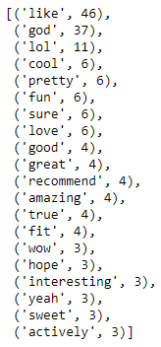
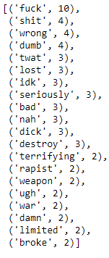
Frequency distribution of the 20 most common positive words:
Ex: positive_words = list(df.loc[df['label'] == 1].words)
positive_frequency = FreqDist(positive_words)
pos_freq = positive_frequency.most_common(20)
Frequency distribution of the 20 most common negative words

Slide 21
Visualization using Word Clouds

Slide 22
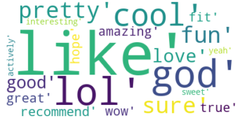
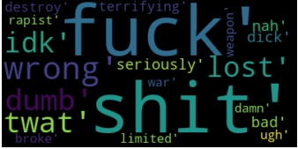
map to a List of strings
join all the strings separated by a comma
Ex:
Pos_words = [str(p) for p in pos_freq]
Pos_words_string = ','.join(Pos_words)
Create and generate a word cloud image
Display the generated image for Positive words and Negative words

Slide 23
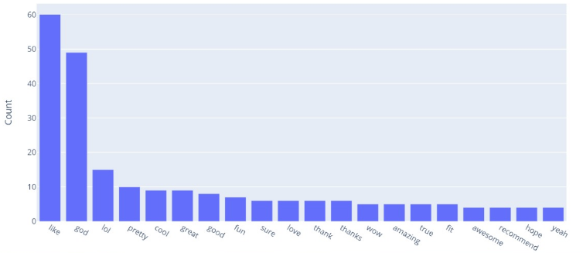
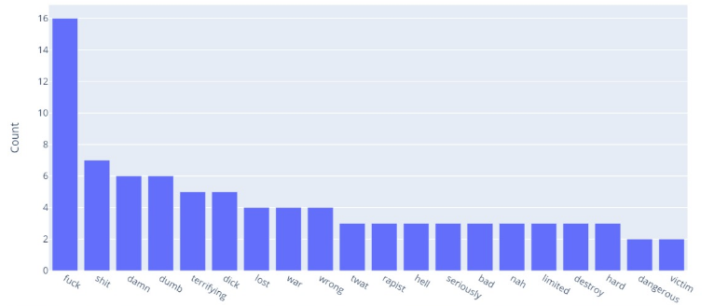
Bar chart of the 20 most common positive words by count
Bar chart of the 20 most common Negative words by count

Slide 24


Thank You…!

